Slide 1
Presented by:
Allie Martorana, Cali Wadsworth, Kaveen Solanki, Thomas Gow, Jacob Laffey, Mikayla Edwards

Slide 2
PRESENTATION AGENDA
Big Data Assessments
Hype Cycle
Architecture
Technology Overview
Vendor Analysis
Conclusion
Foundation Overview
Foundation Mission Statement | Previewing Big Data Assessments | Gartner Technology Hype Cycle | As-Is Architecture | Vendor Venn Diagram | Data Lakes Top 3 Vendors & Magic Quadrant | Risks & Pitfalls
Background |  | Our Technology Hype Cycle | To-Be Architecture | Data Lakes | Machine Learning Top 3 Vendors & Magic Quadrant | References
SWOT Analysis |  |  |  | Machine Learning | Data Visualization Top 3 Vendors & Magic Quadrant
Our Goal |  |  |  | Data Visualization
Key Attributes & Data Elements
Notes:
Cali

Slide 3
PRESENTATION AGENDA
Architecture
Technology Overview
Hype Cycle
Big Data Assessments
Vendor Analysis
Foundation Overview
Conclusion
Notes:
Kaveen

Slide 4
“Guided by the belief that every life has equal value, the Bill & Melinda Gates Foundation works to help all people lead healthy, productive lives. In the United States, it seeks to ensure that all people—especially those with the fewest resources—have access to the opportunities they need to succeed in school and life.”
Notes:
Kaveen

Slide 5
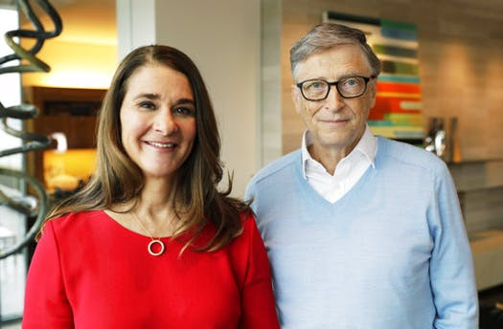
BACKGROUND
QUICK FACTS
Founded in 2002
HQ in Seattle, WA
Provides funds directly to 84 institutions and/or systems of institutions across the US
As of 2017, the total amount of grant payments since it was founded is $45.5 billion.
Notes:
Kaveen

Slide 6
SWOT ANALYSIS
Strong Financial Base
Data Driven
Effective Planning and Monitoring Team
Few Trustees
Lack of Transparency
Resistance from some Governments
Pressure from News outlets
Bilateral Trade
Influence Government policies
High Influence
High Power
Irresponsible Investments
Security Risks
Cultural Barriers
Trust Issues
S
W
O
T
STRENGTHS
WEAKNESSES
OPPORTUNITIES
THREATS
Notes:
Kaveen

Slide 7
OUR GOAL
Our goal is to use the power of technology to help the Bill & Melinda Gates Foundation determine the best possible candidates and institutions to receive funding. We built a new architecture to collect, organize, & analyze structured and unstructured data, which will allow the Gates Foundation to use that data and technology to better predict student outcomes and evaluate the success of the foundation’s investments.
Notes:
ALLIE
1.) Bill & Melinda Gates Foundation: The Gates Foundation has long funded the development of education to underserved communities, socioeconomically challenged, or targeted race and/or ethnicities. In funding these different groups, they provide funds directly to 84 institutions or systems of institutions across the United States. This tradition has made it possible for some of these institutions to remain open. However, there is limited outcomes reported back to Gates on the success of these programs. Student enrollment is provided back to Gates Foundation coupled with retention numbers of students. There is limited exposure to the student lifecycle such as major/study progression, major (CIP code analysis), career placement, graduation outcomes, student returning to communities. There are far more data elements out there that could be used such as Commerce Department “Self-Reported” Career Outcomes, IRS tax filings, Social Media Sites (LinkedIn), Student Graduation Progression (National Student Clearinghouse), Student Debt (Department of Education NSLDS), Career Placement (Burning Glass), and Course Level Analysis. Gates is also curious if this information was located, could you create a model that would predict/prescribe plans for individual students?

Slide 8
KEY ATTRIBUTES & DATA ELEMENTS
Unstructured
Variable | Reasoning | Source
Social Media Content & Usage (Ex. LinkedIn, Instagram) | Quantify influencer ability and what events matter to post. Validation of institutional attributes. | LinkedIn & Instagram
Student’s Involvement | Application of classroom knowledge | LinkedIn, School Records
Public Sentiment of First Company | What type of company they went to/If they are making a difference and solving problems | Run a sentiment analysis on social media of the company
Demographics | See if there is correlation with success and certain demographics in a school | School records
Online Footprint | Run a sentiment analysis of the person and their online footprint | Articles, social media, etc...
Teachers, Classes, Majors, School | What type of education the students are receiving and its application | Course Level of Analysis, Rate My Professor, School Records, School Ranking
Notes:
Cali

Slide 9
KEY ATTRIBUTES & DATA ELEMENTS
Structured
Variable | Reasoning | Source
Grades | Consistency/Improvement of grades | School Records
Starting Salary | Good measure of how well their work in college paid off on the surface level | IRS Tax Filings
Job Placement/Pursuit of Higher Ed | If the school has high job placement track and has strong relationships with companies | School Graduation Survey, Burning Glass
Internship | Application of classroom knowledge | LinkedIn, School Records
Returning to Hometown | Improving the hometown in which students came from | Government Residency
Student Loan Repayment | Students’ history of paying off their loans paired with their major | Department of Education NSLDS
Notes:
Cali

Slide 10
PRESENTATION AGENDA
Architecture
Technology Overview
Hype Cycle
Big Data Assessments
Vendor Analysis
Foundation Overview
Conclusion
Notes:
Mikayla

Slide 11
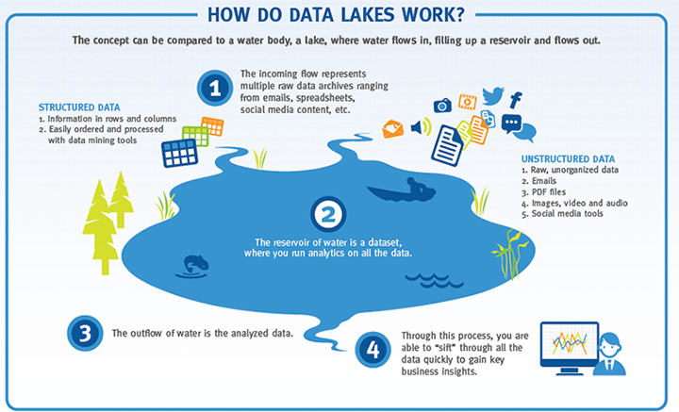
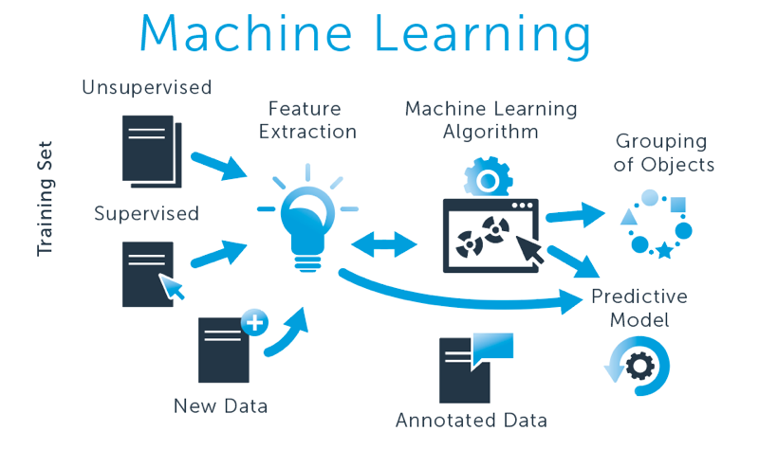
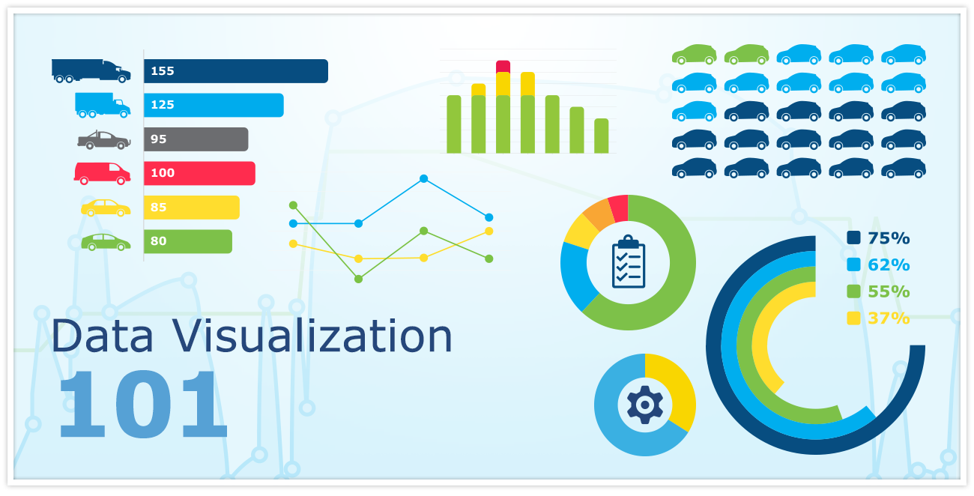
PREVIEWING BIG DATA ASSESSMENTS
Data Lakes
Low cost storage with high scalability
Machine Learning
Using AI to make systems learn and improve automatically
Data Visualization
Representation of data in a graphical format
Notes:
https://www.expertsystem.com/machine-learning-definition/
Mikayla Edwards

Slide 12
PRESENTATION AGENDA
Architecture
Hype Cycle
Technology Overview
Big Data Assessments
Vendor Analysis
Foundation Overview
Conclusion
Notes:
ALLIE

Slide 13
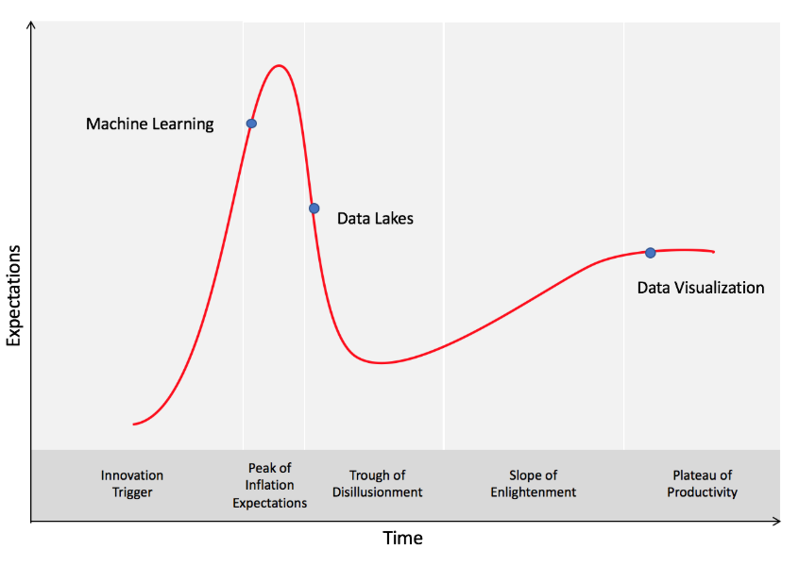
Peak of Inflated Expectations: Early publicity produces a number of success stories — often accompanied by scores of failures. Some companies take action; many do not.
GARTNER TECHNOLOGY HYPE CYCLE
Trough of Disillusionment: Interest wanes as experiments and implementations fail to deliver. Producers of the technology shake out or fail. Investments continue only if the surviving providers improve their products to the satisfaction of early adopters.
Plateau of Productivity: Mainstream adoption starts to take off. Criteria for assessing provider viability are more clearly defined. The technology's broad market applicability and relevance are clearly paying off.
.
Notes:
ALLIE
https://www.gartner.com/en/research/methodologies/gartner-hype-cycle

Slide 14
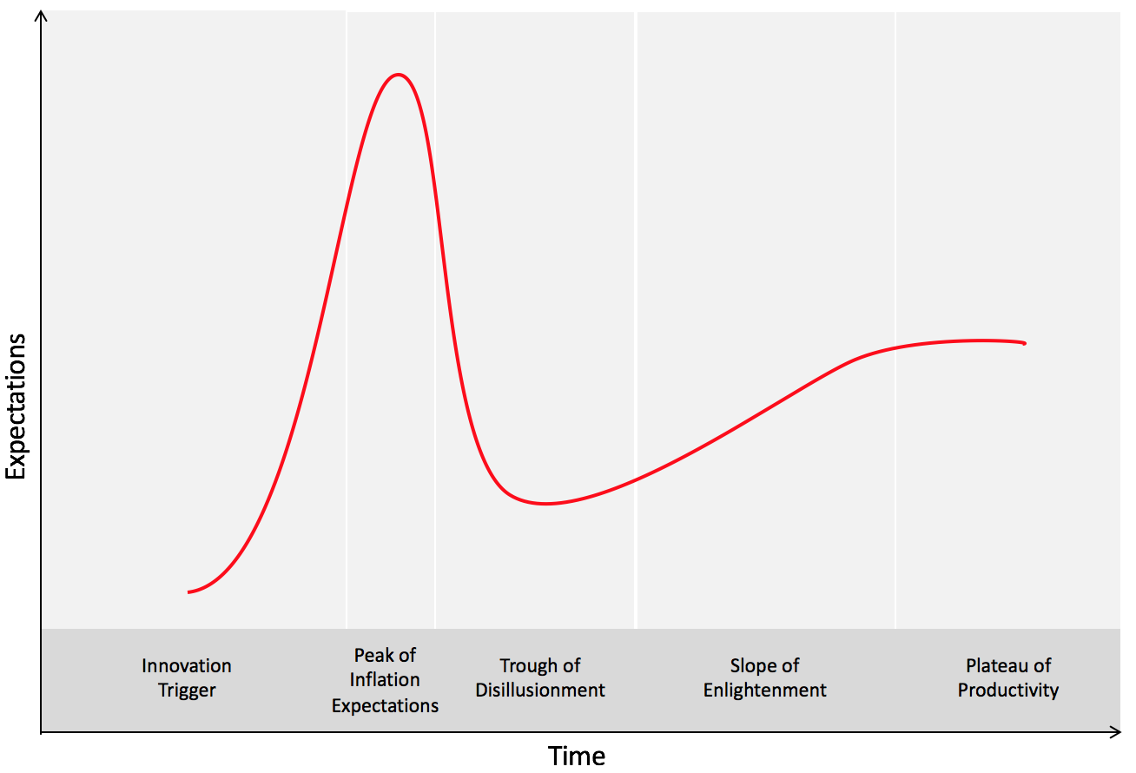
Data Lake: Data lakes are moved to the early stage of the Plateau of Productivity because data lake services are becoming more mainstream and widely used. It is clear now that consumers want a place to securely store large amounts of data at a low cost.
OUR TECHNOLOGY HYPE CYCLE
Machine Learning
Machine Learning: Machine learning has been moved toward the end of the Peak of Inflated Expectations because commercial businesses have successfully adopted this technology. Use cases have been largely understood, and start-ups have formed around the technology.
Data Visualization
Data Lakes
Data Visualization: Data visualization has remained in the Plateau of Productivity stage. According to Forbes, data visualization is in the top five technological initiatives businesses are implementing
Notes:
Data Lakes-ALLIE
Machine Learning-Jacob
Data Visualization- Kaveen
Gartner’s perceptions regarding expectation levels and/or positioning along the curve accurate or inaccurate? What about adoption timelines: conservative, overly optimistic, or about right? Motivate your assessments

Slide 15
PRESENTATION AGENDA
Architecture
Hype Cycle
Technology Overview
Big Data Assessments
Vendor Analysis
Foundation Overview
Conclusion

Slide 16
AS-IS ARCHITECTURE
Available upon request

Slide 17
TO-BE ARCHITECTURE
Available upon request

Slide 18
PRESENTATION AGENDA
Architecture
Technology Overview
Hype Cycle
Big Data Assessments
Vendor Analysis
Foundation Overview
Conclusion
Notes:
Allie

Slide 19
VENDOR VENN DIAGRAM
Machine Learning
Data Visualization
Data Lakes
Notes:
Allie

Slide 20
DATA LAKES
Data Lakes are centralized repositories that allow the storage of large-scale structured and unstructured data. You can store your data as-is, without having to first structure the data, and run different types of analytics—from dashboards and visualizations to big data processing, real-time analytics, and machine learning to guide better decisions.
VENDORS
Notes:
https://solutionsreview.com/data-management/4-data-lake-tools-vendors-to-watch-in-2018/
https://aws.amazon.com/big-data/datalakes-and-analytics/what-is-a-data-lake/
Cali

Slide 21
MACHINE LEARNING
Machine learning technology captures the capability of machines to identify patterns and learn from data in order to perform analyses. Machine learning platforms can perform tasks such as data preparation, model building, and application deployment to automate data analyses to be efficient and more effective than ever before.
VENDORS
Notes:
Jacob
Branch of AI
Data preparation:
Data profiling and data blending
Used to clean data, sort data, and connect data
Examples: operational load times, data value classification, identifying data gaps, self-organization, anomaly detection
Data comes in, it is catalogued with algorithms and models, combined with business rules and application logic
Essentially, it makes the job of data scientists much easier
Gets better over time
Data analysis:
Pre-written and self-written models help analyze data and extract meaningful characteristics
Again, improves itself with time

Slide 22
DATA VISUALIZATION
Data visualization is the graphical representation of information and data. By using visual elements like charts, graphs, and maps, data visualization tools provide an accessible way to see and understand trends, outliers, and patterns in data.
VENDORS
Notes:
Kaveen

Slide 23
PRESENTATION AGENDA
Architecture
Technology Overview
Hype Cycle
Big Data Assessments
Vendor Analysis
Foundation Overview
Conclusion
Notes:
Allie

Slide 24
DATA LAKES TOP 3 VENDORS
Based on several criteria, our team has determined the top 3 data lake vendors that possess qualities that align best with the Gates Foundation’s goals and priorities. The top 3 vendors are Hortonworks, Snowflake, and Cloudera. Data lake vendors were evaluated on two metrics: Reliability and User Value. These metrics include 8 of the most important attributes that thoroughly assess the vendors’ capabilities. This information will be crucial in determining which data lake vendor the Gates Foundation implements into their future data analysis architecture.
Notes:
ALLIE

Slide 25
VENDOR ANALYSIS CRITERIA
Data Lakes
Reliability
Data Security
Data Storage
Stability
Cloud Capabilities
X
User Value
Cost
Speed
Integration
User Interface
Y
Notes:
Cali

Slide 26
MAGIC QUADRANT: DATA LAKES
Reliability
User Value
Notes:
Cali

Slide 27
MACHINE LEARNING TOP 3 VENDORS
Our team developed a method of evaluating the best 3 machine learning vendors based on two main qualitative metrics: Enterprise Support and User Value. Our analysis indicates that the best-in-class vendors are Alteryx, IBM, and DataRobot. These vendors suit the needs of the Gates Foundation, and would prove to be effective in deployment.
Notes:
Jacob

Slide 28
VENDOR ANALYSIS CRITERIA
Machine Learning
Enterprise Support
Security
Price
Scalability
Product Support
Deployment Capabilities
X
User Value
Pre-Written Algorithms
Model Management Tools
Collaboration Features
Automation
Data Preparation Features
Y
Notes:
Jacob

Slide 29
MAGIC QUADRANT: MACHINE LEARNING
Enterprise Support
User Value
Notes:
Jacob
Alteryx:
96% satisfaction rate
May have the edge in data management/preparation
Great integration with data sources
Similar pricing models
Both good enterprise support
IBM Watson:
97% satisfaction rate
May have the edge in analytics

Slide 30
DATA VISUALIZATION TOP 3 VENDORS
The top 3 vendors for data visualization are Tableau, Qlik, and Klipfolio. Data visualization was evaluated on two metrics: Enterprise Support and User Experience. These metrics include 10 of the most important attributes that thoroughly assess the vendors’ capabilities. This information will be crucial in determining which data visualization vendor the Gates Foundation implements.
Notes:
Mikayla Edwards

Slide 31
VENDOR ANALYSIS CRITERIA
Data Visualization
Enterprise Support
Stability
Scalability
Price
Product Support
Deployment
X
User Experience
Data & Analytics
User Interface
Integration
Approachability
Ease of Use
Y
Notes:
Mikayla Edwards

Slide 32
MAGIC QUADRANT: VISUALIZATION
Enterprise Support
User Experience
Notes:
define and defend the two most important Magic Quadrant
Mikayla Edwards

Slide 33
PRESENTATION AGENDA
Architecture
Technology Overview
Hype Cycle
Big Data Assessments
Vendor Analysis
Foundation Overview
Conclusion

Slide 34
Notes:
Cali

Slide 35
REFERENCES
https://aws.amazon.com/big-data/datalakes-and-analytics/what-is-a-data-lake/
https://wasabi.com/blog/best-cloud-storage-data-lake/
https://solutionsreview.com/data-management/4-data-lake-tools-vendors-to-watch-in-2018/
https://www.sas.com/en_us/insights/analytics/machine-learning.html
https://www.gartner.com/en/research/methodologies/gartner-hype-cycle
https://www.forbes.com/sites/louiscolumbus/2017/12/24/53-of-companies-are-adopting-big-data-analytics/#38cb57cd39a1
https://www.gatesfoundation.org/Who-We-Are/General-Information/Foundation-Factsheet

